Slide 1


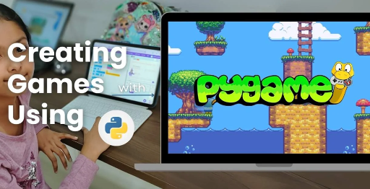
Session 1
Introduction to OMO-Game based Customized PyGame

Slide 2
Learning Objectives
Understand game inspiration, install Pygame-CE, navigate project structure
Detailed Objectives:
Understand the inspiration behind OMO-GAME: Siege of Avaria! (two-player strategy, bird launching, fortress destruction).
Install Python and Pygame-CE and set up the development environment.
Navigate the project directory structure and understand the role of each file.
Run a basic Pygame-CE script to display a window.

Slide 3
Understand game inspiration, install Pygame-CE, navigate project structure
Overview:
OMO-GAME: Siege of Avaria! draws its core inspiration from popular physics-based strategy games like Angry Birds and classic castle siege games, reimagined in a two-player competitive format. The game blends tactical decision-making with engaging destruction mechanics, making it both fun and intellectually stimulating.
Key Inspiration Elements:
Two-Player Strategy Gameplay:
The game is designed for two players who take turns launching birds to destroy each other’s fortresses.
Players must choose the right angle, strength, and bird type to gain a tactical advantage.
Encourages turn-based thinking, predictive targeting, and adapting to opponent moves.
2. Bird Launching Mechanics:
Inspired by slingshot-based games like Angry Birds.
Each bird may have different behaviors (e.g., speed, weight, special effects).
Players use skill and physics understanding to hit strategic points on the opponent’s fortress.

Slide 4
Fortress Destruction:
Each player constructs a fortress using blocks with different strengths and shapes.
The goal is to destroy the opponent’s fortress or eliminate their birds/characters.
Physics-based reactions simulate real-world crashes and collapses.
Install Python and Pygame-CE and set up the development environment.
1. Install Python
Step-by-Step:
Go to the official Python website: https://www.python.org/downloads
Download the latest stable version (e.g., Python 3.11+). Be sure to choose the version suitable for your operating system (Windows/macOS/Linux).
Install Python

Slide 5
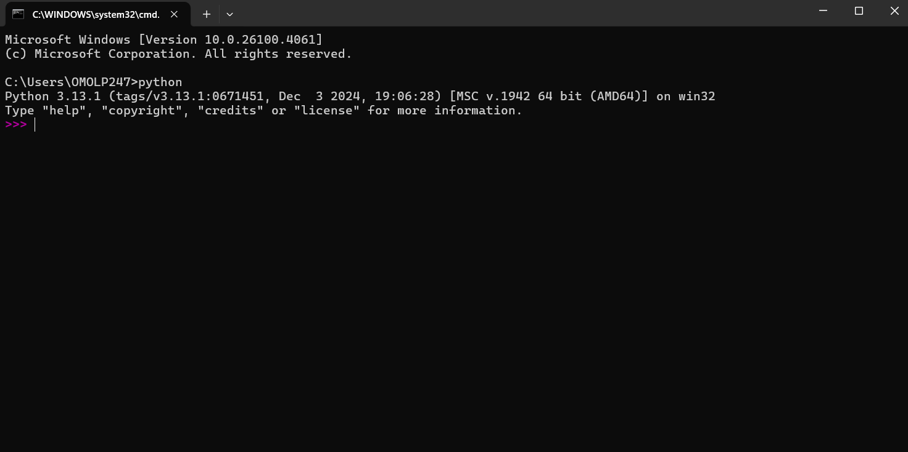
Run the installer.
✅ Important: Check the box “Add Python to PATH” before clicking Install.
Click Install Now and complete the installation.
Verify the installation:
Open a terminal/command prompt.
Type:
python
You should see the version something like:
Python 3.11.x

Slide 6
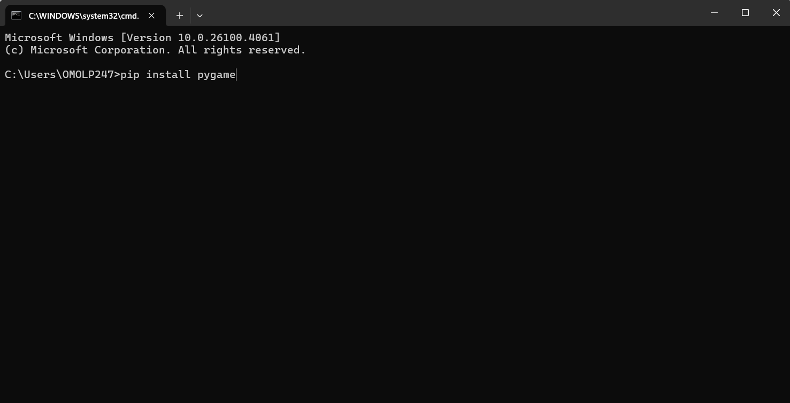
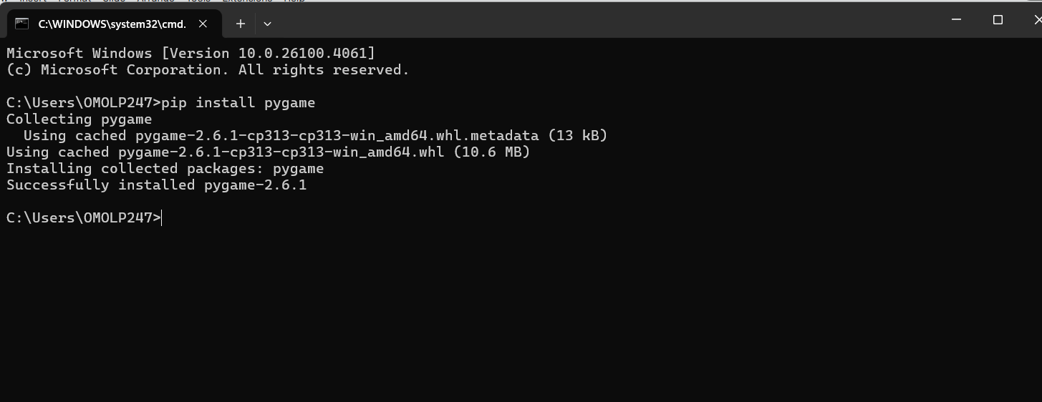
2. Install Pygame-CE (Community Edition)
Why Pygame-CE? Pygame-CE is a modern, actively maintained fork of Pygame — with better support for Python 3.11+ and new features.
Install using pip:
Open a terminal or command prompt and type:
pip install pygame-ce OR pip install pygame

Slide 7
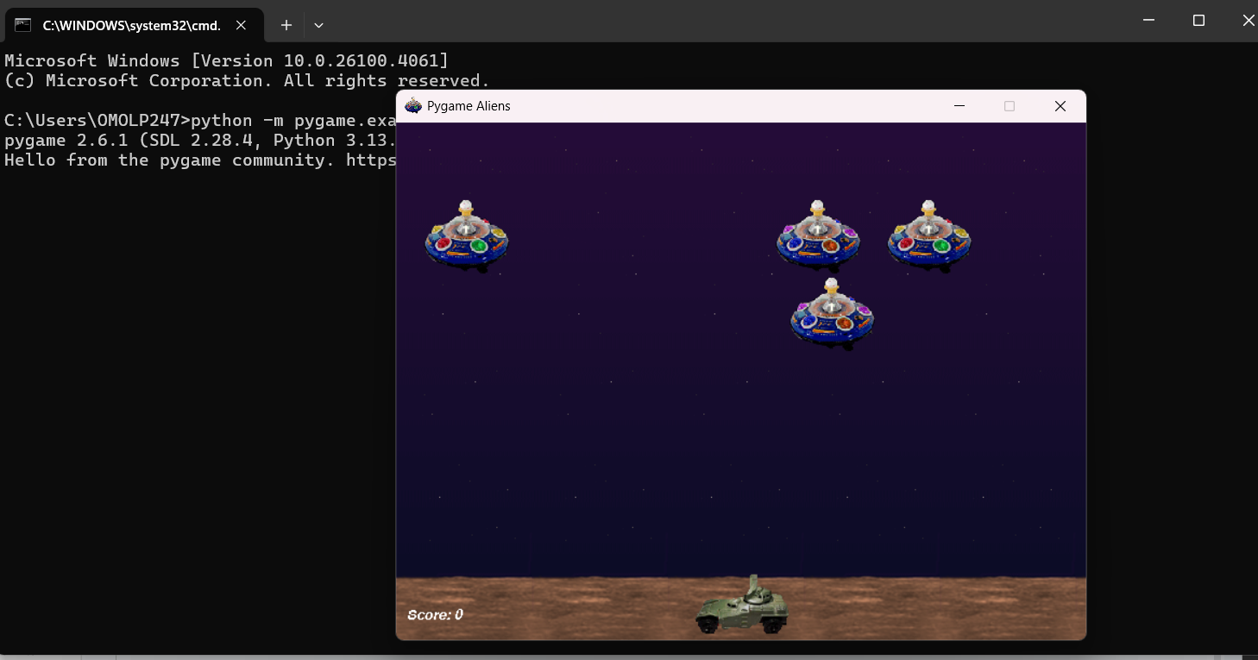
You can also verify it installed correctly:
Just go to your terminal and type this command :- python -m pygame.examples.aliens
This interface will be there on your screen here below is the snap of that

Slide 8
3. Set Up Your Development Environment
Option 1: Use Visual Studio Code (Recommended)
Download from: https://code.visualstudio.com
Install Python extension (search for "Python" in Extensions tab)
Open your project folder or create a new one
Create a new Python file (main.py) and start coding!
Option 2: Use Any Python IDE
Alternatives: PyCharm, Thonny, IDLE, etc.
Make sure Python interpreter is correctly set

Slide 9
OMO-GAME Project Structure Explained:
OMO-GAME/Angry-Birds-using-PyGame-CE
├── main.py
├── assets.py
├── classes.py
├── game_modes.py
├── game_screens.py
├── tools.py
├── README.md
├── media/
│ ├── images/
│ ├── sounds/
│ └── fonts/
└── __pycache__/

Slide 10
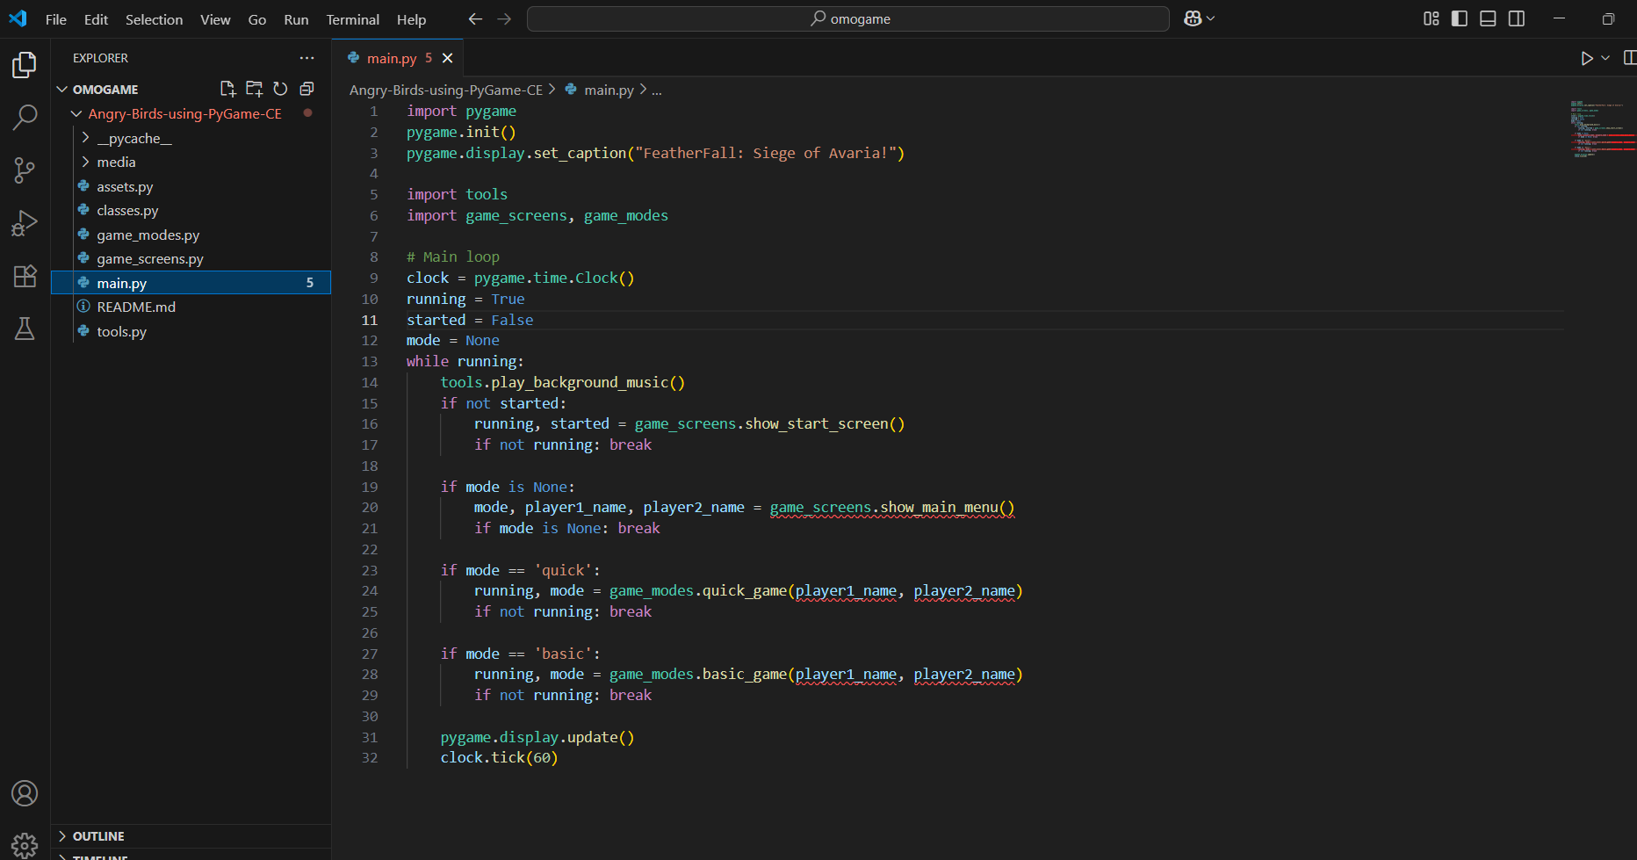
Take a look at the VS Code interface with our project structure and explore it.

Slide 11
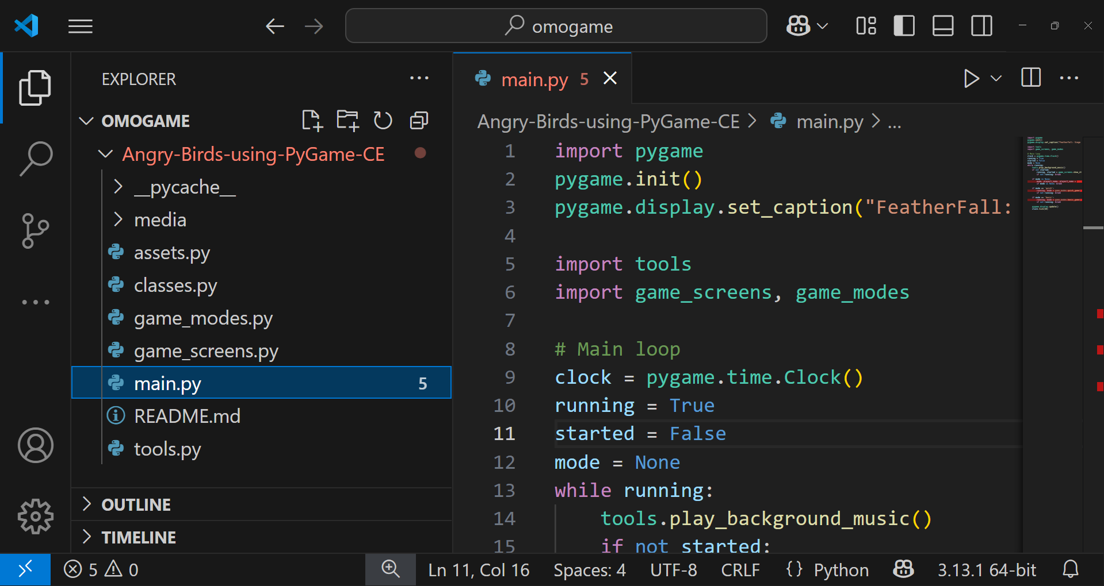
Now we are going to run the main file that is we are going to run the game show the interface how it's going to look like:
To run this game we have to click play that is on top right side of the screen:
Execute PyGame using this Play button

Slide 12
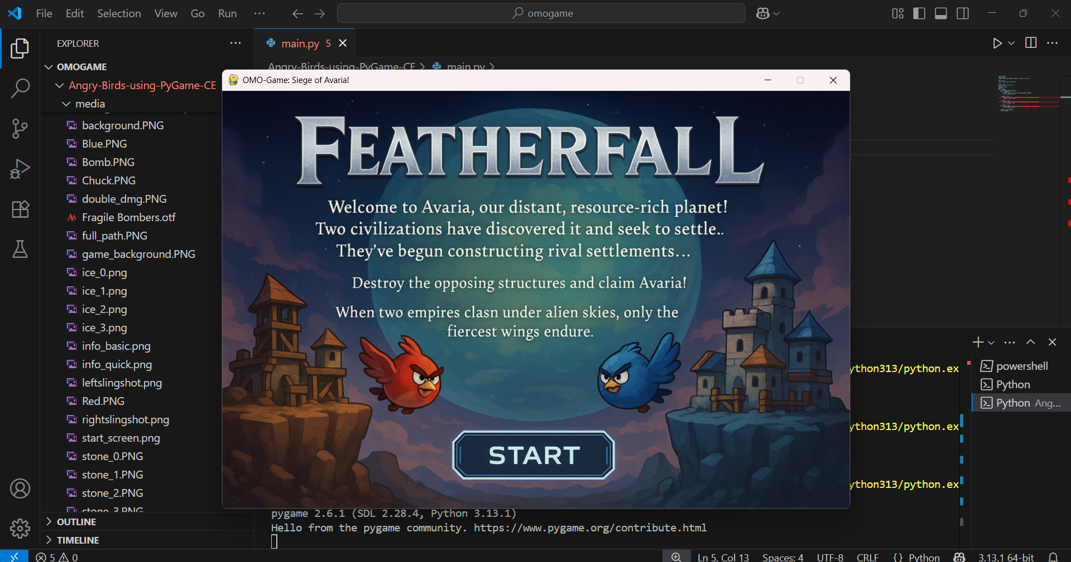
Here is the output and running game of the OMO-GAME:

Slide 13
Explanation of Each File and Folder:
main.py
Main launcher of the game.
Runs the Pygame window and controls the overall flow.
Manages screen transitions like start screen, game screen, and game over.
It's the file you run to start playing the game.
assets.py
Loads and manages images, sounds, and fonts from the media/ folder.
Acts like a library of all game resources.
Helps keep your main game code clean and organized by storing asset paths and loading logic here.

Slide 14
classes.py
Contains all the class definitions used in the game like:
Player
Bird
Fortress block
These classes define the properties and behaviors of each game object.
For example, how the bird moves or how the block reacts when hit.
game_modes.py
Contains logic for different game modes (like quick game or classic mode).
You can easily add or switch between game rules from here.
Keeps gameplay variety and structure modular and organized.

Slide 15
game_screens.py
Manages different screens in the game, such as:
Start screen
Pause screen
Game over screen
Handles user interactions (like clicking “Play” or “Exit”).
Keeps the visual flow of the game clean and user-friendly.
tools.py
Contains helper functions or mini-modules, like:
Physics calculations (bird flight, collisions)
Sound/music controls
Helps re-use common logic across the game.

Slide 16
README.md
A markdown file (text file with styling) that explains:
What the project is
How to run it
Game instructions or credits
Useful for developers, students, or teachers who want to understand or modify the project.
media/
This folder stores all game media (your visual and sound assets):
images/ – Sprites like birds, blocks, backgrounds
sounds/ – Background music and SFX (explosions, launches)
fonts/ – Any custom fonts for the game's UI or score
__pycache__/
This is automatically created by Python.
Stores cached files that make the program run faster.
You don’t need to touch or edit anything here.

Slide 17
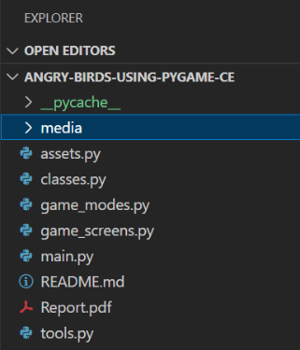
Why This Structure Is Good
It keeps your game well-organized and easy to manage.
You can add new features, update graphics, or change game rules without breaking other parts.
It separates logic (code), media (images/sounds), and configuration (game modes).
GITHUB FINAL COMPLETE CODE REPOSITORY:
https://shorturl.at/5iWe9

Slide 18
Exploring the Game Logic
Physics: Birds follow gravity-based trajectories.
Collisions: Detect hits on blocks/aliens in tools.py.
Turns: Players alternate in game_modes.py.
Scoring: Points for hitting structures/aliens.
Power-Ups: Boost gameplay in Basic mode.
Visuals: Bird trajectory, collision icon; purple theme.
Design Notes: Flowchart of game loop, student avatar analyzing.

Slide 19
Exploring the Game Logic
Physics: Gravity-Based Trajectories
What Does It Mean?
In the game, when a player drags and launches a bird, it doesn't fly in a straight line — instead, it follows a curved path just like real objects do in the real world when affected by gravity (like throwing a ball).
This curve is called a trajectory, and it's shaped like an arc or parabola.
Why Is It Important?
It adds realistic gameplay.
It challenges players to think about angle and power.
It teaches basic physics concepts like force, motion, and gravity — perfect for an educational game.

Slide 20
Exploring the Game Logic
Collisions in tools.py (Short Summary)
Block Collisions: Birds hit blocks using rectangle detection (colliderect). If a hit happens, the block takes damage based on bird type. Broken blocks disappear, and the player scores points.
Alien Collisions: Birds hitting aliens are also checked with rectangles. If an alien is hit, it disappears and the player gets +5 points.
All collision logic is handled in tools.py using functions like check_block_collisions() and check_alien_collisions()
Turns in game_modes.py (Short Summary)
The game is two-player and turn-based.
Players take turns launching birds one at a time.
After a bird finishes its flight, the turn switches:
current_player = 2 if current_player == 1 else 1
This logic is handled in game_modes.py for both Quick and Basic modes.
.

Slide 21
Exploring the Game Logic
Scoring :
Players earn points by hitting:
🧱 Blocks – Points depend on damage dealt (e.g., 10 points per hit).
👽 Aliens – Always give +5 points per hit.
Score increases after each bird's collision.
Scoring is handled in tools.py and used in game_modes.py to check for a win.
Power-Ups in Basic Mode (Short Summary)
Power-ups are special boosts only available in Basic Mode.
Each player gets two power-ups:
🟢 Full Path – Shows the entire bird trajectory before launch.
🔥 Double Damage – Makes the bird hit blocks twice as hard.
Players click on the power-up icon to activate it during their turn.
Managed in basic_game() inside game_modes.py.

Slide 22
Exploring the Game Logic
Visuals:
The game has a fun purple theme for background and UI.
Shows bird trajectory with dotted lines before launch.
Collision effects like block breaking and alien hits are visually animated for impact.
Design Notes:
A simple flowchart explains the game loop: Start → Play → Score → Switch Turn → Win.
A student avatar can be used to point out tips or explain parts of the game (great for learning and fun).

Slide 23
Modification of the First Module
Start with main.py: Controls game flow.
Tweak Colors: Change background in screen.fill().
Add Text: Use assets.py fonts to show “Hello!”.
Try Sounds: Add a sound from media/ folder.
Test Changes: Run and see your updates!
Visuals: Code snippet, sound icon; purple theme.
Design Notes: Text boxes for tweaks, avatar experimenting.

Slide 24
Modification of the First Module
Start with main.py
This file controls the overall game flow like switching between screens and starting gameplay. All major functions like background music and screen transitions begin here.
Tweak Colors
You can change the background color by editing screen.fill() in tools.py or main.py. Try colors like (255, 255, 255) for white or (100, 0, 200) for purple.
Add Text
Use fonts from assets.py to display messages using .render() and screen.blit(). For example, show “Hello!” on the screen in a fun font.
Try Sounds
Add a sound file (like click.wav) from the media/ folder and play it with pygame.mixer.Sound(). You can trigger it when a bird launches or a button is clicked.
Test Changes
Run the game after making edits to see how your changes appear. Check if colors, text, or sounds are working as expected.

Slide 25
Modification of the First Module
Visuals
Show a code snippet box with changes highlighted and a sound icon near buttons or birds. Keep the purple theme consistent to match your game's style.
Design Notes
Add text boxes in your UI to label custom changes or settings. A student avatar can appear on screen trying new features and guiding players.

Slide 26
Exploring Student Mini Project
Project Goal: Add a new feature to the game.
Ideas: New bird type, custom block, or score display.
Steps: Plan, code in classes.py, test.
Team Up: Work with friends to brainstorm.
Show Off: Present your feature to the class!
Visuals: New bird icon, team avatar; yellow theme.
Design Notes: Flowchart of project steps, yellow text boxes.

Slide 27
Exploring Student Mini Project
🎯 Project Goal
The goal is to add a new feature that improves or customizes the game. This helps you learn coding creatively while making the game more fun.
Ideas
You could create a new bird with special powers, design a custom block, or enhance the score display. Pick something small but exciting that can change how the game feels.
Steps
First, plan your idea and sketch it out. Then code it inside classes.py and test it in the game.
Team Up
Work with your friends or classmates to come up with cool ideas. Sharing thoughts makes the project more fun and creative.
Show Off
Once done, present your feature to the class and explain how it works. You can even demo it live to show what you built.

Slide 28
Exploring Student Mini Project
Visuals
Use a new bird icon or design element in yellow to match the theme. Add a team avatar image to represent you and your group.
📝 Design Notes
Make a simple flowchart to explain the steps from idea to testing. Use yellow text boxes in your slides or posters to highlight key parts.

Slide 29
Wrap-Up & What's Next
You Did It!: Learned game dev basics.
Keep Coding: Tweak more files like tools.py.
Explore More: Try Pygame-CE tutorials online.
Next Project: Build your own game idea!
Questions?: Ask your teacher or friends!
Visuals: Checkmark, gamepad; yellow background.
Design Notes: Checklist layout, excited student avatar.

Slide 30
Wrap-Up & What's Next
You Did It!
You’ve successfully learned the basics of game development using Pygame-CE. Great job building and understanding your first game!
💻 Keep Coding
Keep improving by exploring and editing other files like tools.py. Try changing how birds move, blocks behave, or how scores are shown.
Explore More
Check out Pygame-CE tutorials online to learn cool tricks and features. You can discover animations, effects, and even sound upgrades.
Next Project
Use what you’ve learned to build your own game idea from scratch. It could be a puzzle, platformer, or even a racing game!

Slide 31
Wrap-Up & What's Next
Show a big checkmark and a gamepad icon on a bright yellow background. These visuals celebrate success and connect to the gaming theme.
📝 Design Notes
Use a checklist format to show what you’ve completed in the project. Add a happy student avatar at the end cheering your success.

Slide 32
Resources & Support
Pygame Docs: pyga.me/docs for code help.
Tutorials: YouTube Pygame playlists (e.g., bit.ly/pygame-tuts).
Assets: Freepik for free game art.
Teacher Help: Ask for setup or code tips.
Community: Join online Pygame forums!
Visuals: Link icon, book; yellow theme.
Design Notes: Text boxes for resources, avatar with laptop.

Slide 33

Exercise:
1. What is the primary objective of the Quick Mode in OMOGAME?
A) Collect all power-ups before the opponent
B) Launch birds without any destruction
C) Reach a score of 200 points
D) Complete the entire storyline
Answer: C) Reach a score of 200 points
2. Which file is considered the main entry point of the OMOGAME project? A) tools.py
B) main.py
C) assets.py
D) classes.py
Answer: B) main.py

Slide 34
Exercise..
3. What does the tools.py file mainly handle in the game?
A) Launching sound and animation
B) Player avatar selection
C) Collision detection and drawing functions
D) Managing game instructions
Answer: C) Collision detection and drawing functions
4. Which of the following is NOT listed as a unique feature of OMOGAME? A) Bird classes with special physics
B) Alien targets for bonus points
C) Multiplayer online matchmaking
D) Destructible block environments
Answer: C) Multiplayer online matchmaking

Slide 35
Exercise…
5. Why is organizing the OMOGAME project into files like classes.py, media/, and game_modes.py important?
A) It reduces the game’s memory usage
B) It helps reduce the number of bugs completely
C) It makes the project look colorful
D) It simplifies managing and updating different game parts
Answer: D) It simplifies managing and updating different game parts

Slide 36
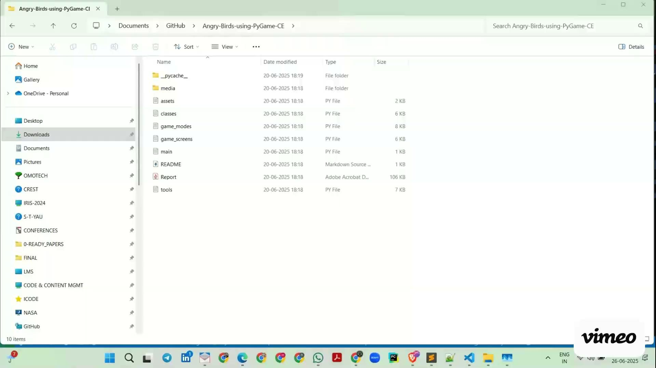
Session 1 VIDEO LINK
Introduction to OMO-Game based Customized PyGame

